Slide 1
Stop Asking for Permission!
Leading from a Place of Making
(Things Happen)
aka—An arts leader’s guide on getting your way by helping others get theirs.
Bolz Center for
Arts Administration

Slide 2
MBA students at Wisconsin School of Business participate in art-making as part of their leadership training

Slide 3
What’s your super power?

Slide 4
From Illinois farm kid to managing director of one of the largest university theatre programs in the country

Slide 5
Creative Arts Ensemble—
Black Music I becomes music business practicum

Slide 6

Two roads diverged in a wood. And I – I took the one less traveled by.
What the hell was I thinking?
-RF and SW

Slide 7
It is better to ask forgiveness than for permission.
Mark Suster, writing at Both Sides of the Table:
I have always believed in the saying, "It's better to beg for forgiveness than to ask for permission." It's a way of life.
It's not about abusing situations but about knowing when to push the boundaries. It's about knowing that the overwhelming number of people in life are naysayers and "no sayers" and sometimes you gotta just roll the dice and say why the hell not.

Slide 8
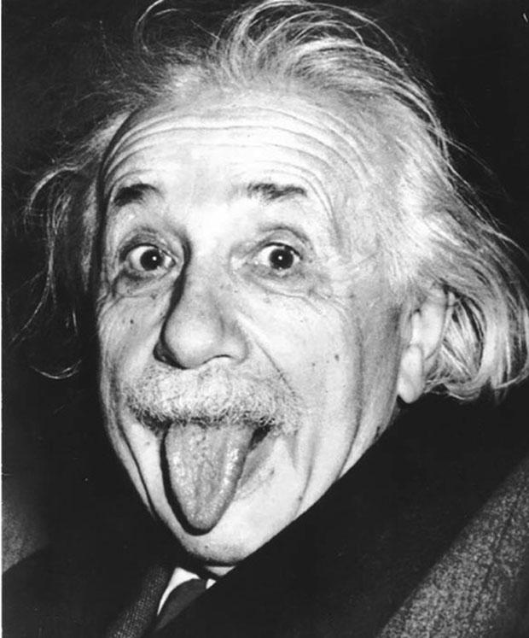
Learning Outcome #1:
Don’t always try to be the smartest person in the room.

Slide 9
TRUTH
Whatever may be the limitations which trammel inquiry elsewhere we believe the great state University of Wisconsin should ever encourage that continual and fearless sifting and winnowing by which alone the truth can be found. | ”
— 1894 Ely trial committee final report, via Herfurth's Sifting and Winnowing

Slide 10
GOODNESS
THE WISCONSIN IDEA university research should be applied to solve problems and improve health, quality of life, the environment, and agriculture for all citizens of the state.
MILWAUKEE — CUTTING $300 Million from the University System budget…
…The initial draft of Gov. Walker’s budget bill also proposed to rewrite the university’s 110-year-old mission statement, known as the Wisconsin Idea, deleting “the search for truth” and replacing it with language about meeting “the state’s work-force needs.”
--Feb. 16, 2015—The New York Times

Slide 11

WHAT ABOUT
BEAUTY?
BEAUTY:
IT BRINGS US DELIGHT
IT IS MEMORABLE
IT IS WORTH REVISITING

Slide 12

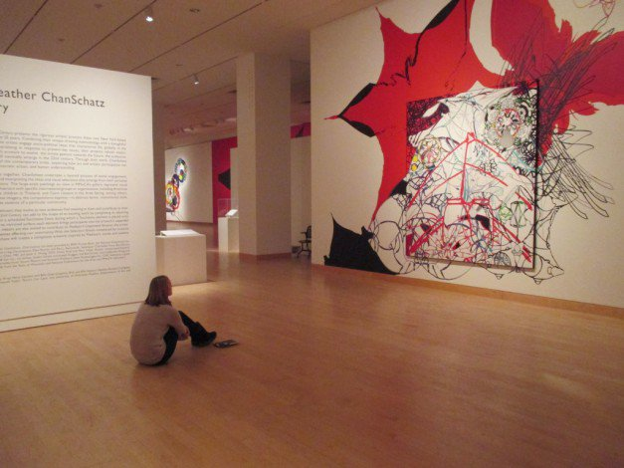
Aesthetics in
Business aka
Beauty in a Business School

Slide 13
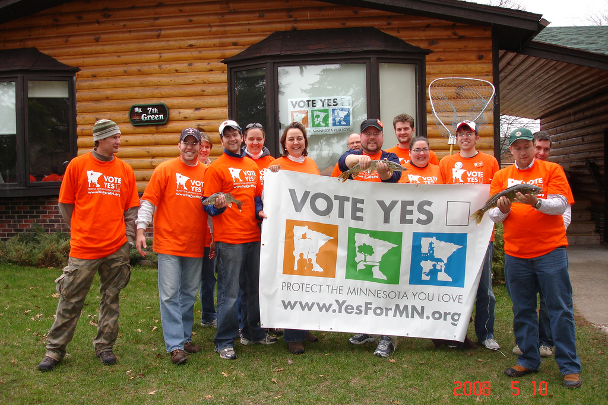
Clean Water, Land and Legacy Amendment

Slide 14
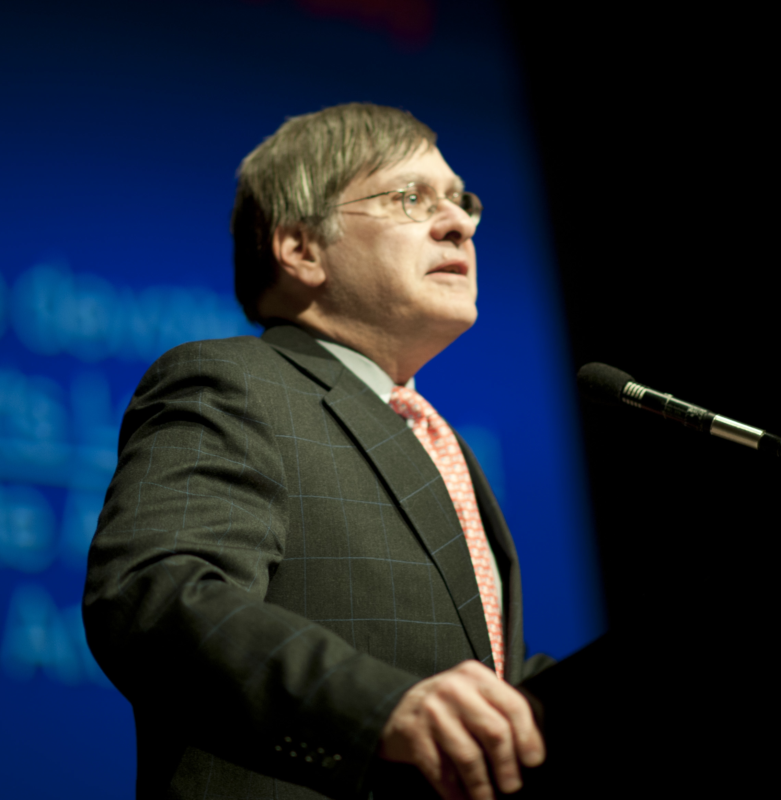
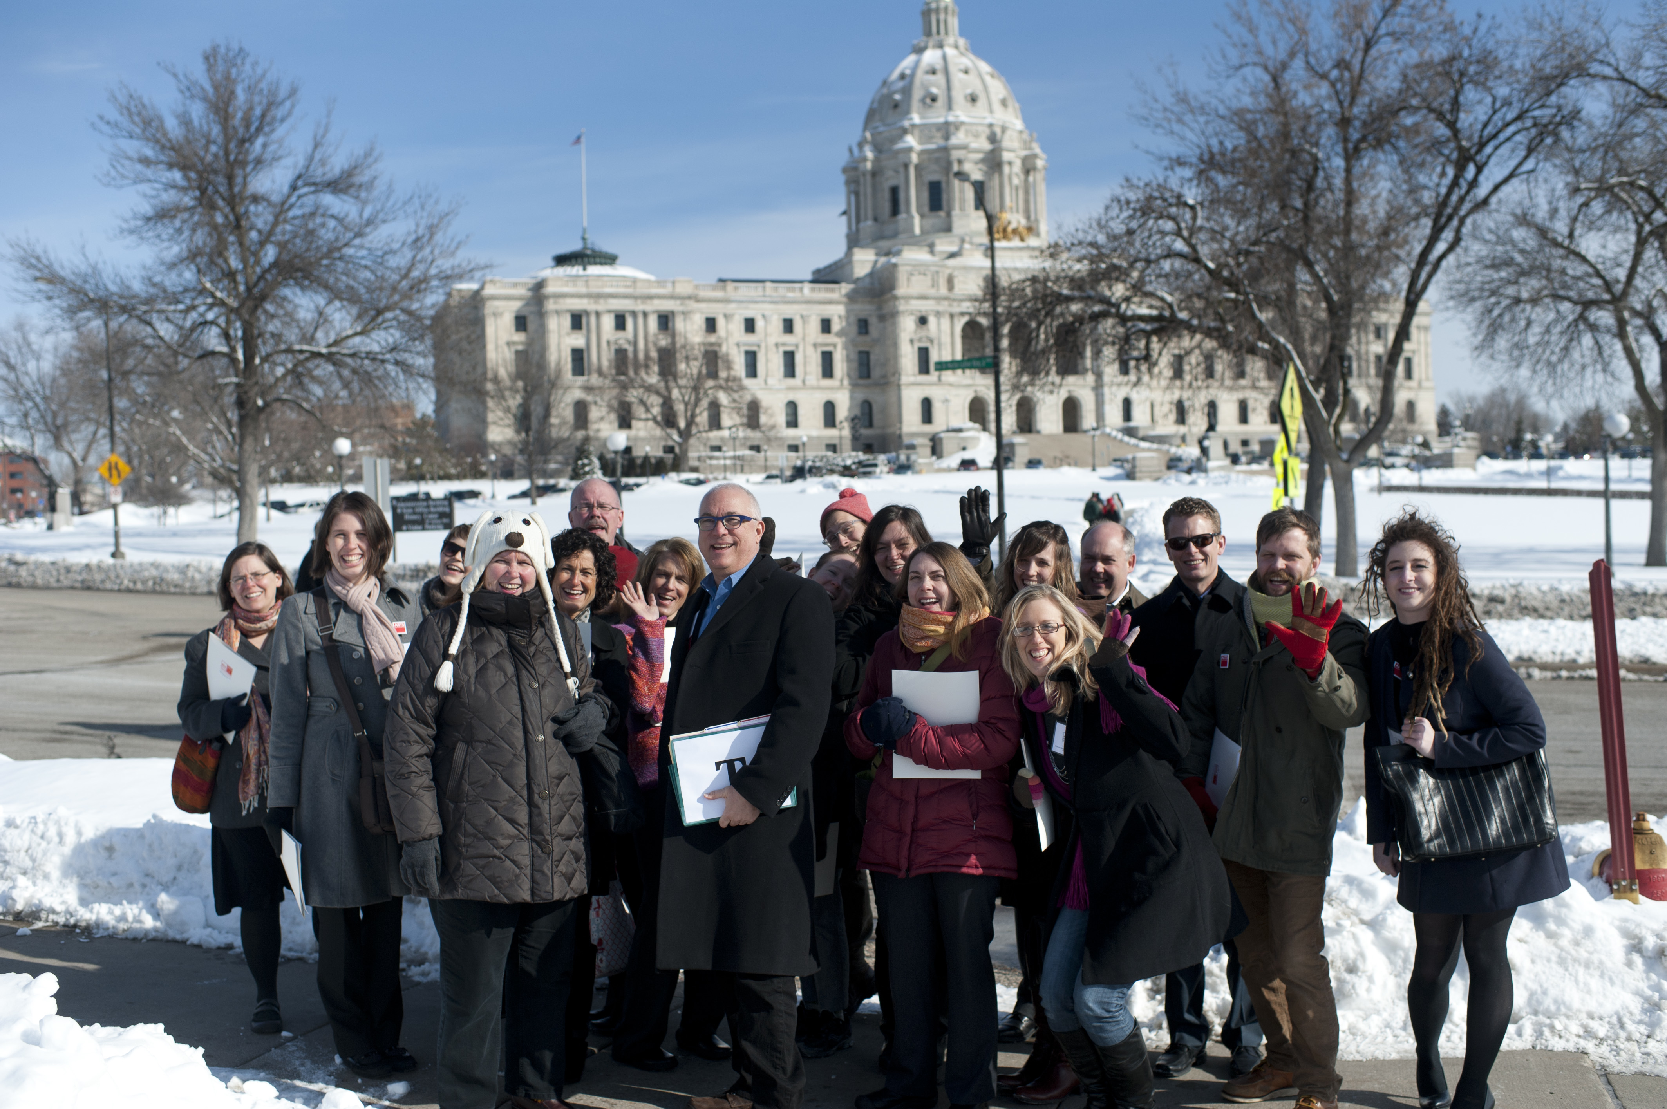
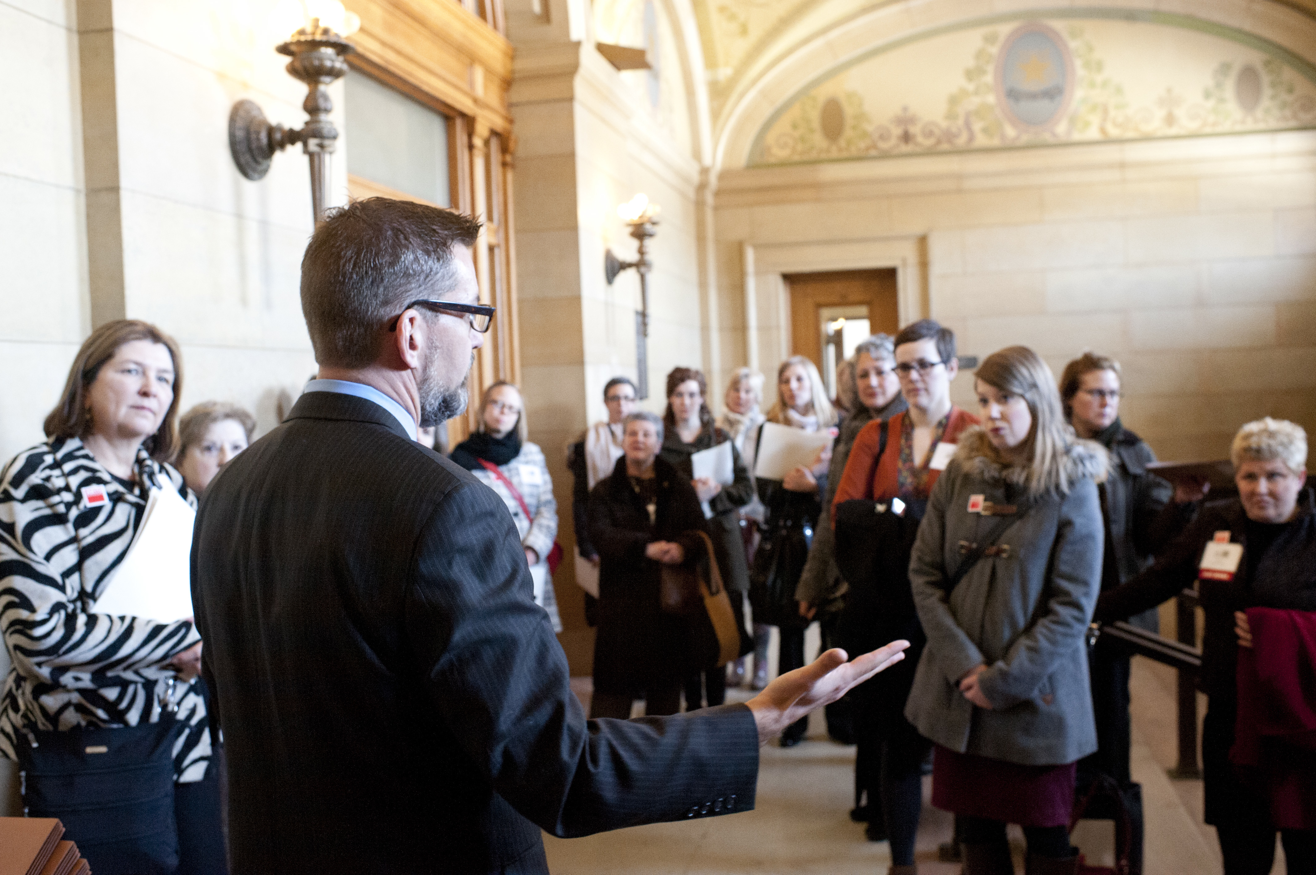
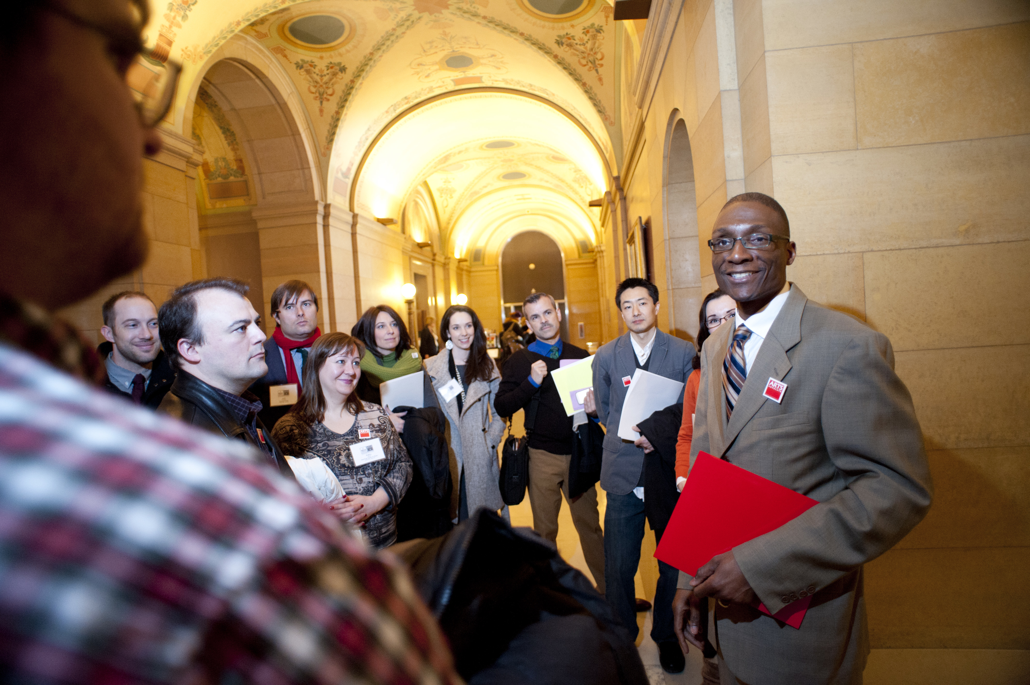
They all got together

Slide 15



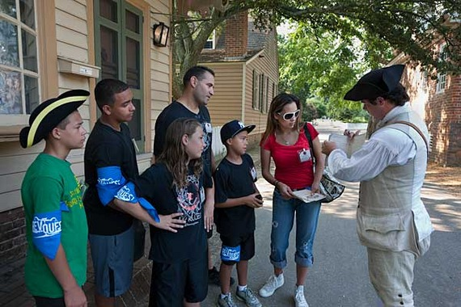
PASSED BY A COALITION OF:
ARTS ORGANIZATIONS +:
CONSERVATIONISTS
Passed in 2008
Increased state sales tax by 0.375%
by an amendment to the state constitution
Lasts 25 years
HUNTERS & ANGLERS
HISTORY & PARK ADVOCATES

Slide 16

A tale of two oranges

Slide 17
Make a great ensemble

Slide 18
Don’t ask for permission…
But DO ask for ADVICE!!

Slide 19
MHR 765:
NONPROFIT BOARD LEADERSHIP
COURSE

Slide 20
NO ONE TOLD THEM THEY COULD…
BUT NO ONE TOLD THEM THEY COULDN’T…

Slide 21
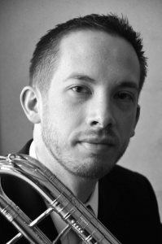
Alan G. Carr
Bass Trombone and
Music Manager of Olin Arts
BATES COLLEGE

Slide 22

Artists and
Scientists and
Engineers, oh my!

Slide 23
What Problems Are You Solving?
How Great Artists Think Like Entrepreneurs…

Slide 24

Challenge
#1

Slide 25
Challenge
#2

Slide 26
Find a way to do what you want to do…
…by helping someone else do what they need to do.
Or, get yours by helping someone else get theirs.

Slide 27

Remember that farm kid?

Slide 28
OFFER UP YOUR
SUPER
POWER!

Slide 29

FIND
THAT
CAPE!

